Slide 1
Updates & Reminders
This week: Chapters 8 & 9: cellular functions of the tumor suppressors pRB and p53
Tonight by midnight: Project Submission Due
Check the grading ruberic to make sure you include all components
References with corresponding in text citations
Superscript in text = numbered references
(Author et al., year) in text = alphabetical list
Follow citation format guidelines. ALL relevant info(authors, title, journal, pages, date, etc) MUST be included in Nature format
Graphic that includes details of molecular interactions
Which proteins/genes are part of this pathway
Which order do these proteins/genes interact in
How so these proteins/genes impact each other (promote/inhibit function)

Slide 2
Chapter 8: pRB and Cell Cycle Control
Objectives
Be able to define the function of the cell cycle
Be able to describe the 4 cell cycle checkpoints: what each monitors, and the expected consequences if one or more is abrogated
Understand different ways protein function is regulated and be able to discuss examples of when each type of regulation may be used

Slide 3
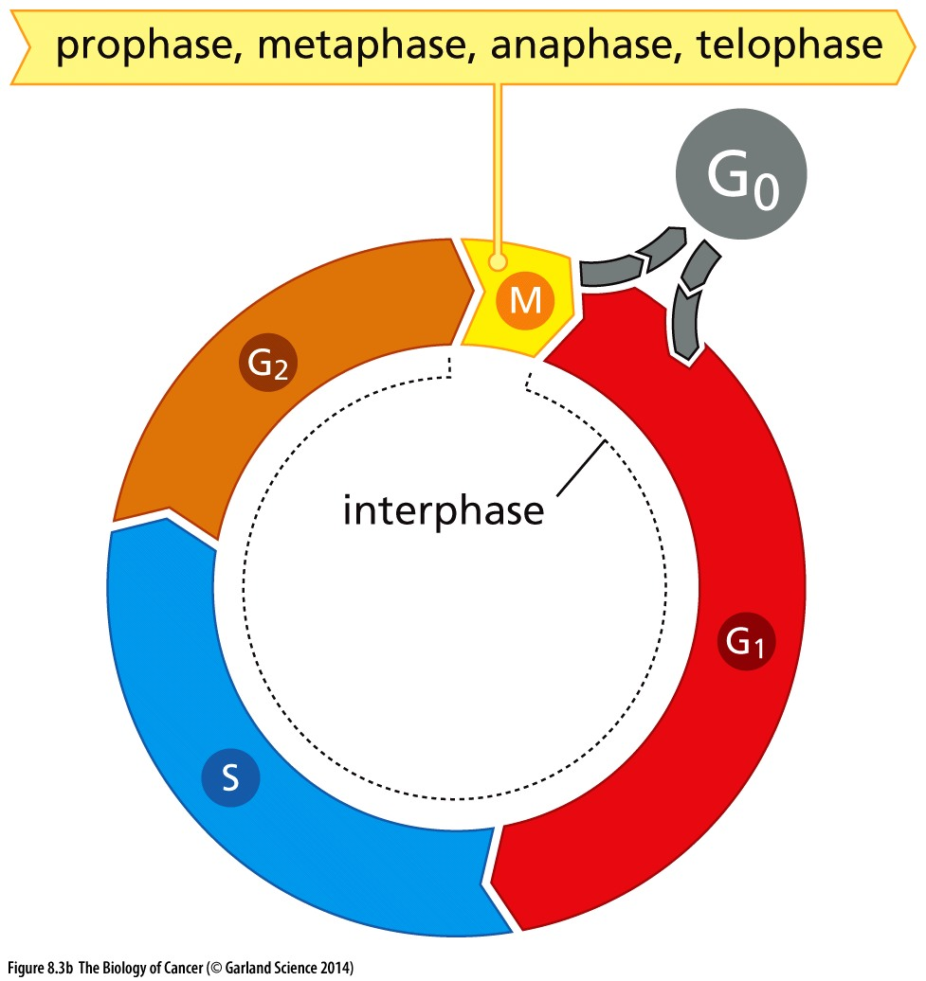

Cell cycle regulation
To be tumorigenic, a cell MUST proliferate inappropriately to generate additional cancer cells
The function of the cell cycle is the faithful duplication and equal separation of the genome during cell division
Cellular checkpoints are in place to ensure the cell is best equipped to do this

Slide 4
Cell cycle regulation
G1/S checkpoint monitors:
Mitogenic signalling (GFs)
Inhibitory signalling (TGF-beta)
for DNA damage
Intra-S phase & G2/M checkpoints monitor:
For DNA damage
Anaphase checkpoint monitors:
Chromosome attachment to the spindle microtubules

Slide 5
Cell cycle regulation
G1/S checkpoint monitors:
Mitogenic signalling (GFs)
Inhibitory signaling (TGF-beta)
for DNA damage
Intra-S phase & G2/M checkpoints monitor:
For DNA damage
Anaphase checkpoint monitors:
Chromosome attachment to the spindle microtubules
How do oncogenic TRKs promote proliferation?
Inhibition of which checkpoint might have a similar impact?

Slide 6
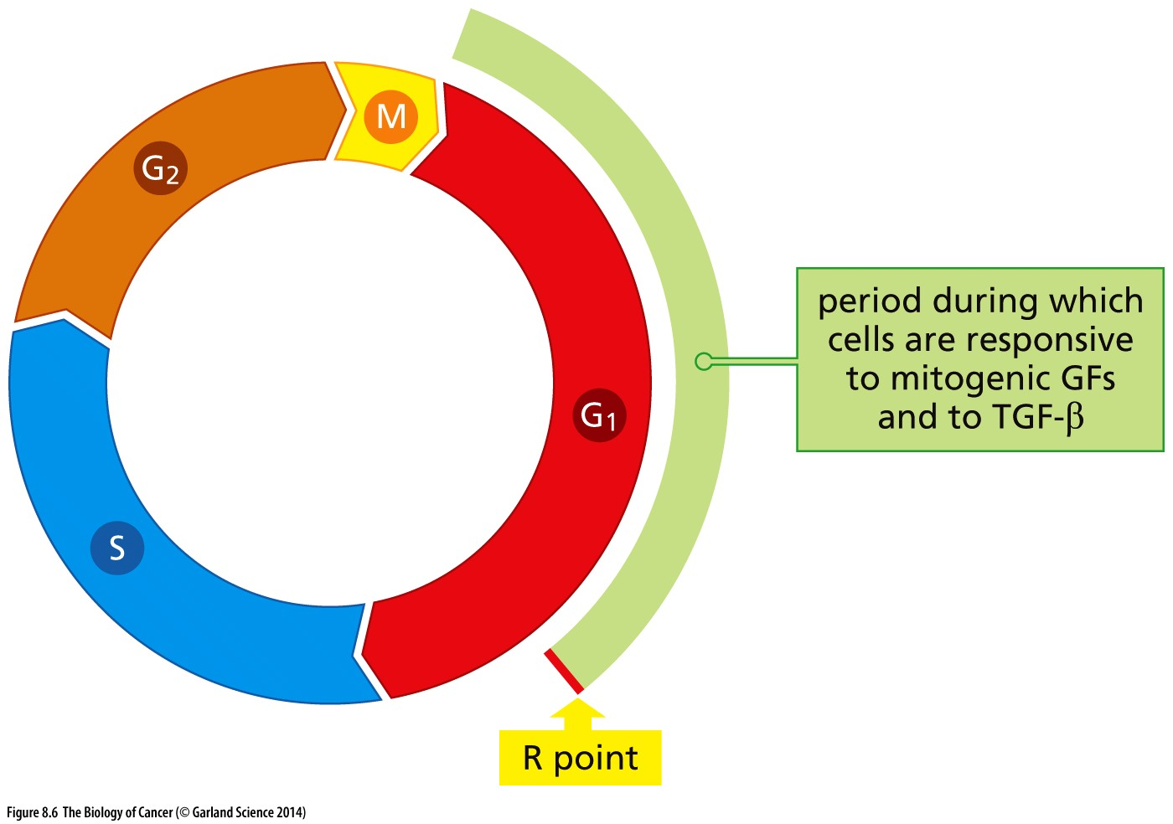
Cell cycle commitment
How do oncogenic TRKs promote proliferation?
oncogenic TRKs impact a cell’s decision to commit to a new cell cycle
Inhibition of which checkpoint might have a similar impact?
Abrogation of the G1/S checkpoint does the same
Restriction point: “Point of no return”
Mitogenic signal present? Nutrients available? Genome intact?
Yes → proceed to S phase
No → enter G₀/quiescence

Slide 7
Why a “point of no return”?
Why MUST a cell continue forward once it passes the R point?
At the G1/S transition replication is initiated: Replication must happen ONLY ONCE
Replication initiating complexes sit on chromatin and are primed to start replication upon S phase entry
How is protein function regulated?
Proteins required for replication initiation are turned over/degraded → not made again until the next G1

Slide 8
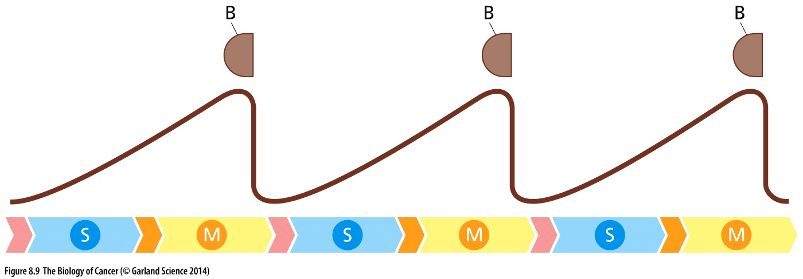
Protein degradation for irreversible regulation
Cyclin protein accumulates with cell cycle progression
Cyclin
Amount of cyclin protein
→ → → Cell cycle stage → → →

Slide 9
Protein degradation for irreversible regulation
Cyclin protein accumulates with cell cycle progression
Cyclin degradation at key steps in the cell cycle prevents cells from moving backwards
Cyclin
Amount of cyclin protein
→ → → Cell cycle stage → → →

Slide 10
Protein degradation for irreversible regulation
Cyclin protein accumulates with cell cycle progression
Cyclin degradation at key steps in the cell cycle prevents cells from moving backwards
Repeats this pattern with each cell cycle
Different Cyclin proteins have different expression profiles
Cyclin
Cyclin
Cyclin
Amount of cyclin protein
→ → → Cell cycle stage → → →

Slide 11
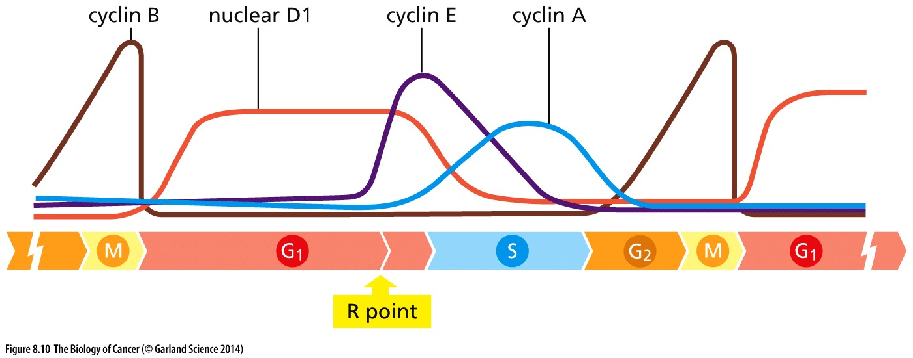
Protein degradation for irreversible regulation
Cyclin protein accumulates with cell cycle progression
Cyclin degradation at key steps in the cell cycle prevents cells from moving backwards
Different Cyclin proteins have different expression profiles
Amount of cyclin protein
→ → → Cell cycle stage → → →

Slide 12
Protein degradation for irreversible regulation
Cyclin expression/degradation patterns define cell cycle progression
Protein degradation is irreversible so the cell cycle ONLY moves forward
Amount of cyclin protein
What function do cyclins serve? How do they regulate cellular pathways?

Slide 13
How is protein activity regulated?
Expression level: protein synthesis and degradation (cyclins)
Protein interactions (ligand binding, dimerization, protein complexes)
Covalent modifications (phosphorylation, methylation, etc)
Which types of regulation are reversible? Which are faster/slower?
Why might this level of control be needed?

Slide 14
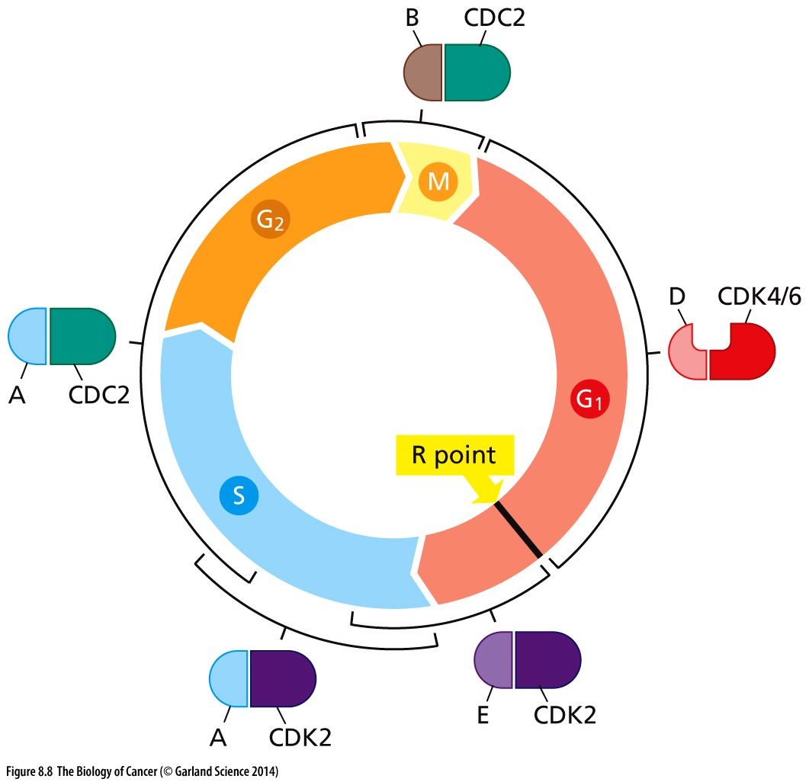
Different cyclins @ different cell cycle stages
Each cyclin protein complexes with one or two specific cyclin dependent kinases
Binding to cyclin activates the kinase
Kinase activity regulates important cellular functions
→ checkpoints!

Slide 15
pRB is regulated by Cyclin/CDK activity
pRB’s function as a checkpoint protein is regulated by phosphorylation
Cyclin D/CDK4/6 and Cyclin E/CDK2 phosphorylate pRB at the end of G1
pRB is inactivated by this phosphorylation → silencing the G1/S checkpoint
pRB is a dominant regulator of this checkpoint

Slide 16
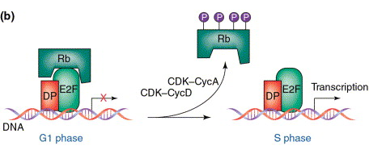
pRB’s cellular function
pRB binds to and sequesters the E2F family of transcriptional regulators
RB-E2F/DP is inactive
No transcription
Phosphorylation of pRB disrupts its interaction with E2F/DP
E2F/DP is free to promote expression of genes needed for S phase

Slide 17
Promoting cyclin activity
Cyclin expression is:
influenced by extracellular signals
Mitogens: Cyclin D
Self propagating
Cyclins from the previous cell cycle activate those in the subsequent phase

Slide 18
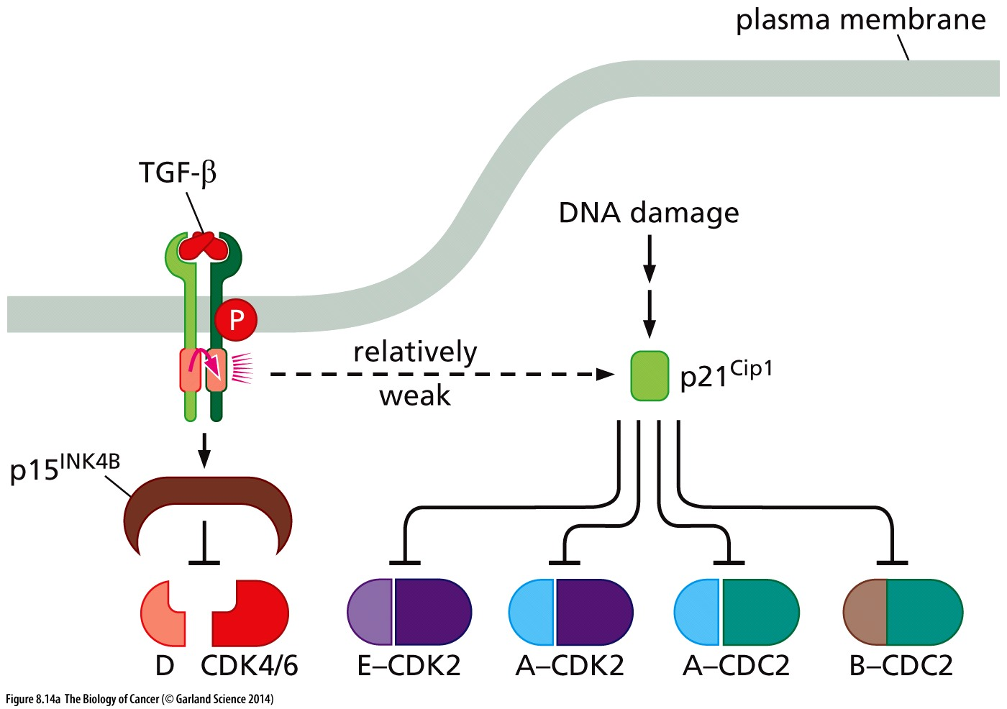
Inhibiting cyclin/CDK activity
CDK inhibitors regulate CDK complexes
Promoted by external signals that antagonize cell proliferation
TGF-β ligand binding → signal cascade
Promoted by internal signals
DNA damage
Different CDK inhibitors inhibit different Cyclin/CDK complexes

Slide 19
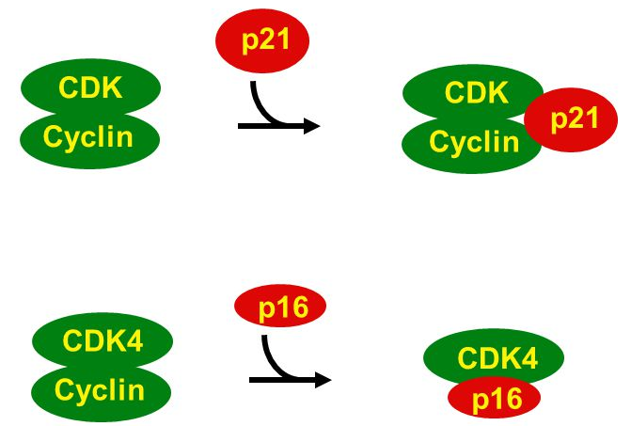
Mechanisms of CDK inhibition
To regulate cell cycle progression, Cyclin/CDK complexes must be able to phosphorylate substrates in the nucleus
Can bind to Cyclin/CDK complex and prevent kinase activity
i.e. p15 and p16 (INK family of CKD inhibitors) to Cyclin D/CDK4
Active Inactive

Slide 20
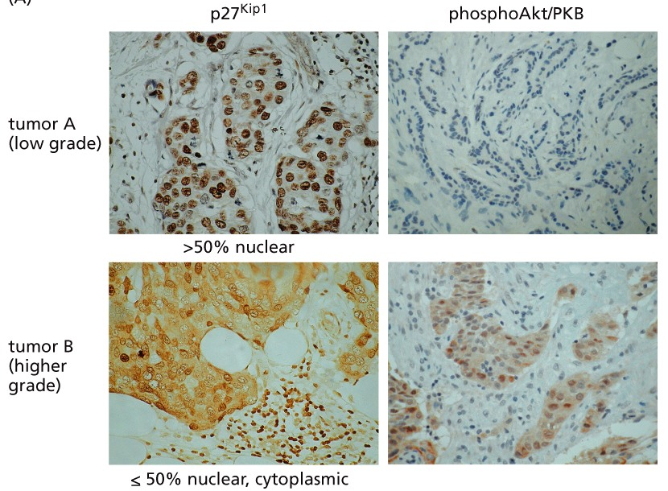
Mechanisms of CDK regulation
To regulate cell cycle progression, Cyclin/CDK complexes must be able to phosphorylate substrates in the nucleus
Can bind to and translocate Cyclin/CDK complexes to the cytoplasm
RTK→ → → AKT/PKB → p27^{KIP1} –I CDK localization in nucleus

Slide 21
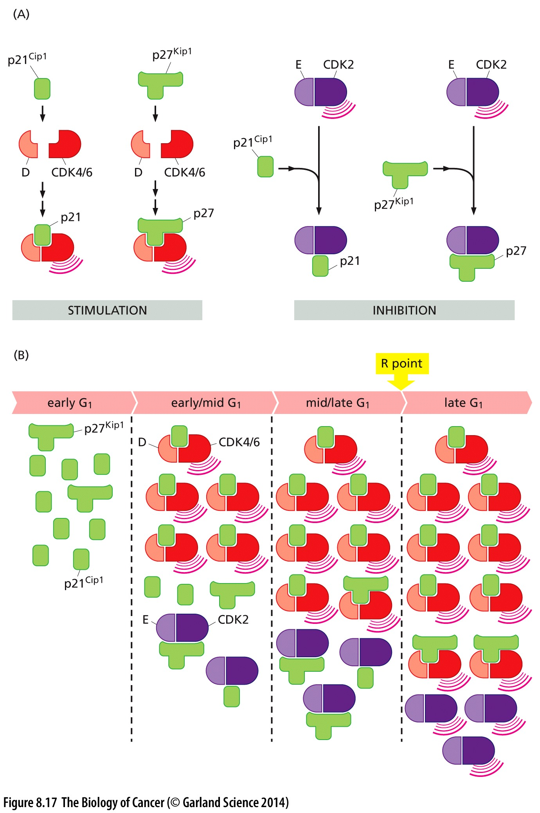
Inhibitors of some CDKs, activators of others
p21 and p27 activate CyclinD/CDK4/6
SAME proteins inactivate CyclinE/CDK2
Poor planning? Or clever design?

Slide 22
Inhibitors of some CDKs, activators of others
Promotes linear progression through the cell cycle→ only one Cyclin active at a time
Cyclin D/CDK levels build
Sequester p27/p21
CyclinE/CDK complexes are liberated from inhibition

Slide 23
Modeling Complex Pathways
Pathway components:
pRB
E2F
Cyclin
CDK
CDKi
RTKs
mitogens
Can you map or model their interactions?
Can you predict which would be tumor suppressors?
which might be activated as oncogenes in cancer?

Slide 24
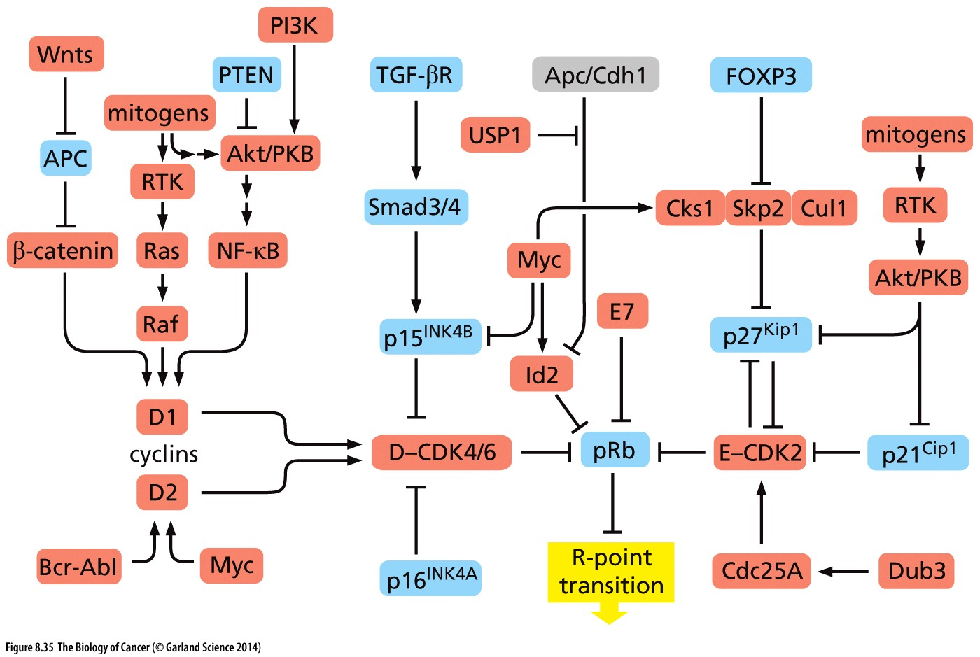
Many layers of regulation!
CDKi –I Cyclin/CDK –I RB –I S phase transition

Slide 25
Many layers of regulation!
Mitogens → RTKs → → Cyclin/CDK –I RB –I S phase transition

Slide 26
Many layers of regulation!
External signals → → → CDKi –I Cyclin/CDK –I RB –I S phase transition

Slide 27
Many layers of regulation!
Myc transcription factors contribute to inhibiting pRB function

Slide 28
Many layers of regulation!
Why all this regulation?
How is this pathway corrupted in cancer?

Slide 29
Cell cycle commitment
Would you expect that corruption of this checkpoint alone is sufficient to cause cancer?
Restriction point: “Point of no return”
Mitogenic signal present? Nutrients available? Genome intact?
Yes → proceed to S phase
No → enter G₀/quiescence

Slide 30
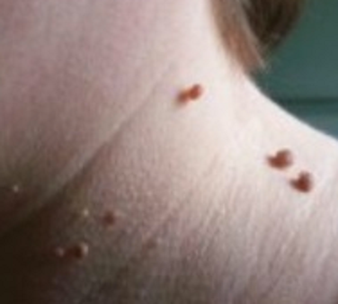
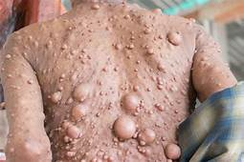
Over-proliferation and Cancer
Uncontrolled proliferation alone is necessary (& often an early step in tumor initiation) but is not sufficient to cause cancer
What does this mean?
Transient over-proliferation can cause skin tags and moles
Persistent over-proliferation can cause benign (non-malignant) tumors
Ex: neurofibromatosis: caused by mutations in the tumor suppressor gene NF1
Increased proliferation
Other mutations
Cancer!

